Slide 1

Phishing URL Detection Using Machine Learning
Presenters:
Alekya G
Pavan CH
Siva Ganesh K

Slide 2
INTRODUCTION
Phishing is the most used social engineering and cyber attack.
Through such attacks, the phisher targets naïve online users by tricking them into revealing confidential information, with the purpose of using it fraudulently.
To avoid getting phished,
users should have awareness of phishing websites
have a blacklist of phishing websites which requires the knowledge of website being detected as phishing.
detect them in their early appearance, using machine learning and deep neural network algorithms.
Of the above three, the machine learning based method is proven to be most effective than the other methods.
Even then, online users are still being trapped into revealing sensitive information in phishing websites.

Slide 3
OBJECTIVES
A phishing website is a common social engineering method that mimics trustful uniform resource locators (URLs) and webpages.
The objective of this project is to train machine learning models and deep neural nets on the dataset created to predict phishing websites.
Both phishing and benign URLs of websites are gathered to form a dataset and from them required URL and website content-based features are extracted.
The performance level of each model is measures and compared.

Slide 4
APPROACH
Below mentioned are the steps involved in the completion of this project:
Collect dataset containing phishing and legitimate websites from the open-source platforms.
We present a phishing URL dataset using legitimate login websites to obtain the URLs from phishing detecting solutions like Phish tank, Open Phish.
Analyze and preprocess the dataset by using List-based approach, machine learning methods, Deep Learning methods.
Divide the dataset into training and testing sets.
Run selected machine learning and deep neural network algorithms like SVM, Random Forest, Logistic Regression classifier ,K-nearest Neighbors, Decision Tree classifiers , Gradient Boosting on the dataset.
Predict a URL for displaying the evaluation result considering accuracy metrics.
Compare the obtained results for trained models and specify which is better

Slide 5

DATA COLLECTION
• We collected the legitimate URLs from the Top Million Quantcast website, https://www.quantcast.com/products/measure-audience-insights/ ,which provides the most visited domains from the United States.
• From the collection, 90K URLs are randomly picked.
• We have created a new dataset named Phishing Index Login URL (PILU-90K), which is composed of 60K legitimate URLs, including index and login websites, and 30K phishing URLs.

Slide 6
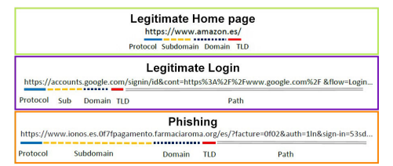
DATASET-PILU(PhishingIndexLoginURL)-90k
Phishers use login forms to retrieve and steal users' data.
As far as we are concerned, the legitimate class in most phishing datasets are represented by URLs from their homepages.
30K legitimate URLs of homepages, 30K legitimate login URLs and 30K phishing URLs.

Slide 7
MACHINE LEARNING MODELS
This is a supervised machine learning task. There are two major types of supervised machine learning problems, called classification and regression.
This data set comes under classification problem, as the input URL is classified as phishing (1), legitimate (0), Defacement(2).
The machine learning models (classification) considered to train the dataset in this notebook are: Light Gradient Boosting Machine (LightGBM), Extreme Gradient Boosting (XGBoost), Adaptive Boosting (AdaBoost), Random Forest (RF), Support Vector Machines (SVM), k-Nearest Neighbours (kNN), Naìve Bayes (NB) and Logistic Regression (LR).

Slide 8
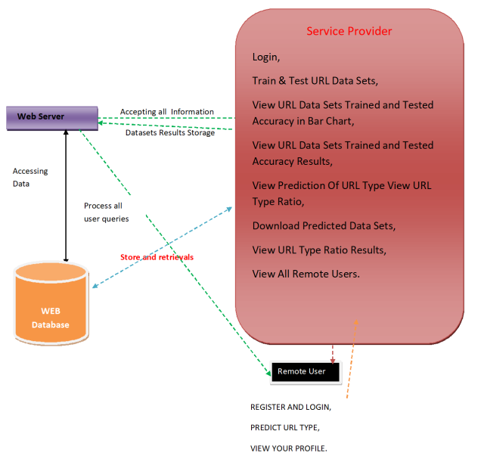
System Architecture

Slide 9
Modules
SERVICE PROVIDER: Access requires a valid username and password, granting entry to numerous services. Users can explore Train and Test Data Sets for URLs, view the accuracy of these sets through a bar chart, check URL type predictions, download predicted datasets, and analyze URL type ratios.
REMOTE USER: Registration is essential for remote user and details stored post sign-up from login page, they are utilized to like registration, login, URL type prediction, and profile viewing.

Slide 10
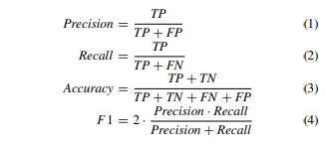
Evaluation and Performance Metrics
Experiments are executed on an Intel Core i5. We used scikit-learn and Python 3 for the implementation of different datasets.
Accuracy, Precision, Recall, and F1-Score Evaluate the effectiveness of phishing URL detection algorithms using commonly used performance metrics.
TP denotes the true positives, i.e., how many phishing websites were correctly classified.
FP refers to the false positives and represents the number of legitimate samples wrongly classified as phishing.
TN (i.e., the true negatives) denotes the number of legitimate samples correctly classified.
Finally, FN represents the false negatives that represent the number of phishing websites misclassified as legitimate ones.

Slide 11
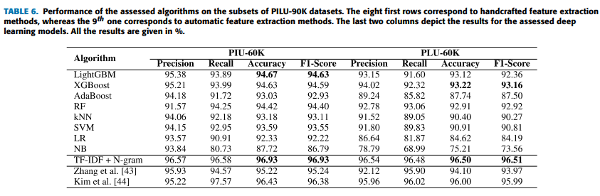
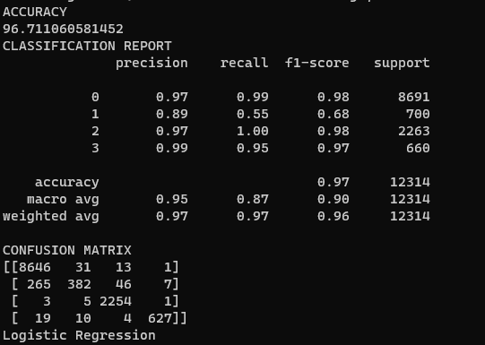
Results
Notably, our TF-IDF and N-gram approach, trained with PLU-60K, mitigates this issue by accurately classifying legitimate login samples
Finally, we present a Logistic Regression model using Term Frequency-Inverse Document Frequency (TF-IDF) feature extraction, achieving 96.50% accuracy on the login URL dataset.

Slide 12
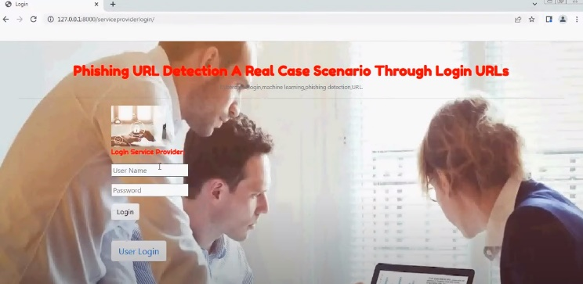
Execution of Project -Homepage

Slide 13

Conclusion
By leveraging machine learning techniques, researchers and practitioners can make significant advancements in phishing URL detection. Further research is needed to address evolving threats and improve detection accuracy.

Slide 14


